Slide 1
S Dhanushree
Final Project

Slide 2
Text-to-Video Generation using a Generative AI

Slide 3
AGENDA
02
03
01
End users
Problem statement
Project Overview
04
05
06
Solution
Modelling
Result

Slide 4
The task of automatically transforming a given text to video is known as text to video generation. The creation of text captions from videos has been the main focus of earlier research on the generative link between text and video. Nevertheless, current approaches find it difficult to handle the converse challenge of creating films from text. A conditional generative model is trained in this study to extract both static and dynamic information from text in order to address the challenge.
Problem Statement

Slide 5
This project delves into the exciting world of generating videos from plain text descriptions. It aims to bridge the gap between text-based content, which can be plentiful but static, and engaging video formats. Traditional video creation is a time-consuming process requiring specialized skills. Text content, while abundant, often lacks the visual punch to truly captivate viewers.
Project Overview

Slide 6



End Users
Individual Creators
Advocates
Businesses & Organizations

Slide 7
Solution And Value Proposition
This project investigates the autonomous generation of films using artificial intelligence (AI) and text input. Imagine creating engaging and educational movies out of scripts, articles, or summaries. The following industries might see a revolution in content generation thanks to this technology:
Education - Videos that explain difficult subjects Sales and Marketing - Captivating product showcases Social Media: Captivating material for several channels News & Reporting: Effectively Visualizing Breaking News Stories

Slide 8
Wow in my Solution
The development of Text-2-Video models poses a more formidable challenge. The goal is to achieve coherence and consistency across each generated frame and maintain generation context from the video's inception to its conclusion.
Yet, recent advancements in Diffusion-based models offer promising prospects for Text-2-Video tasks as well. My solution involves utilizing a fine-tuned model provided by PyTorch and Pipelines, which proves instrumental in generating the videos.

Slide 9
Modelling
We use the Diffusers library provided by HuggingFace, and a utility library called Accelerate, that allows PyTorch code to run in parallel threads. This speeds up our generation process. We load the Text-2-Video model provided by ModelScope on HuggingFace, in the Diffusion Pipeline. The model has 1.7 billion parameters and is based on UNet3D architecture that generates a video from pure noise through an iterative de-noising process. It works in a 3-part process. The model firsts perform text-feature extraction from the simple English prompt. The text features are then encoded to the video latent space and de-noised. Lastly, the video latent space is decoded back to the visual space and a short video is generated.

Slide 10
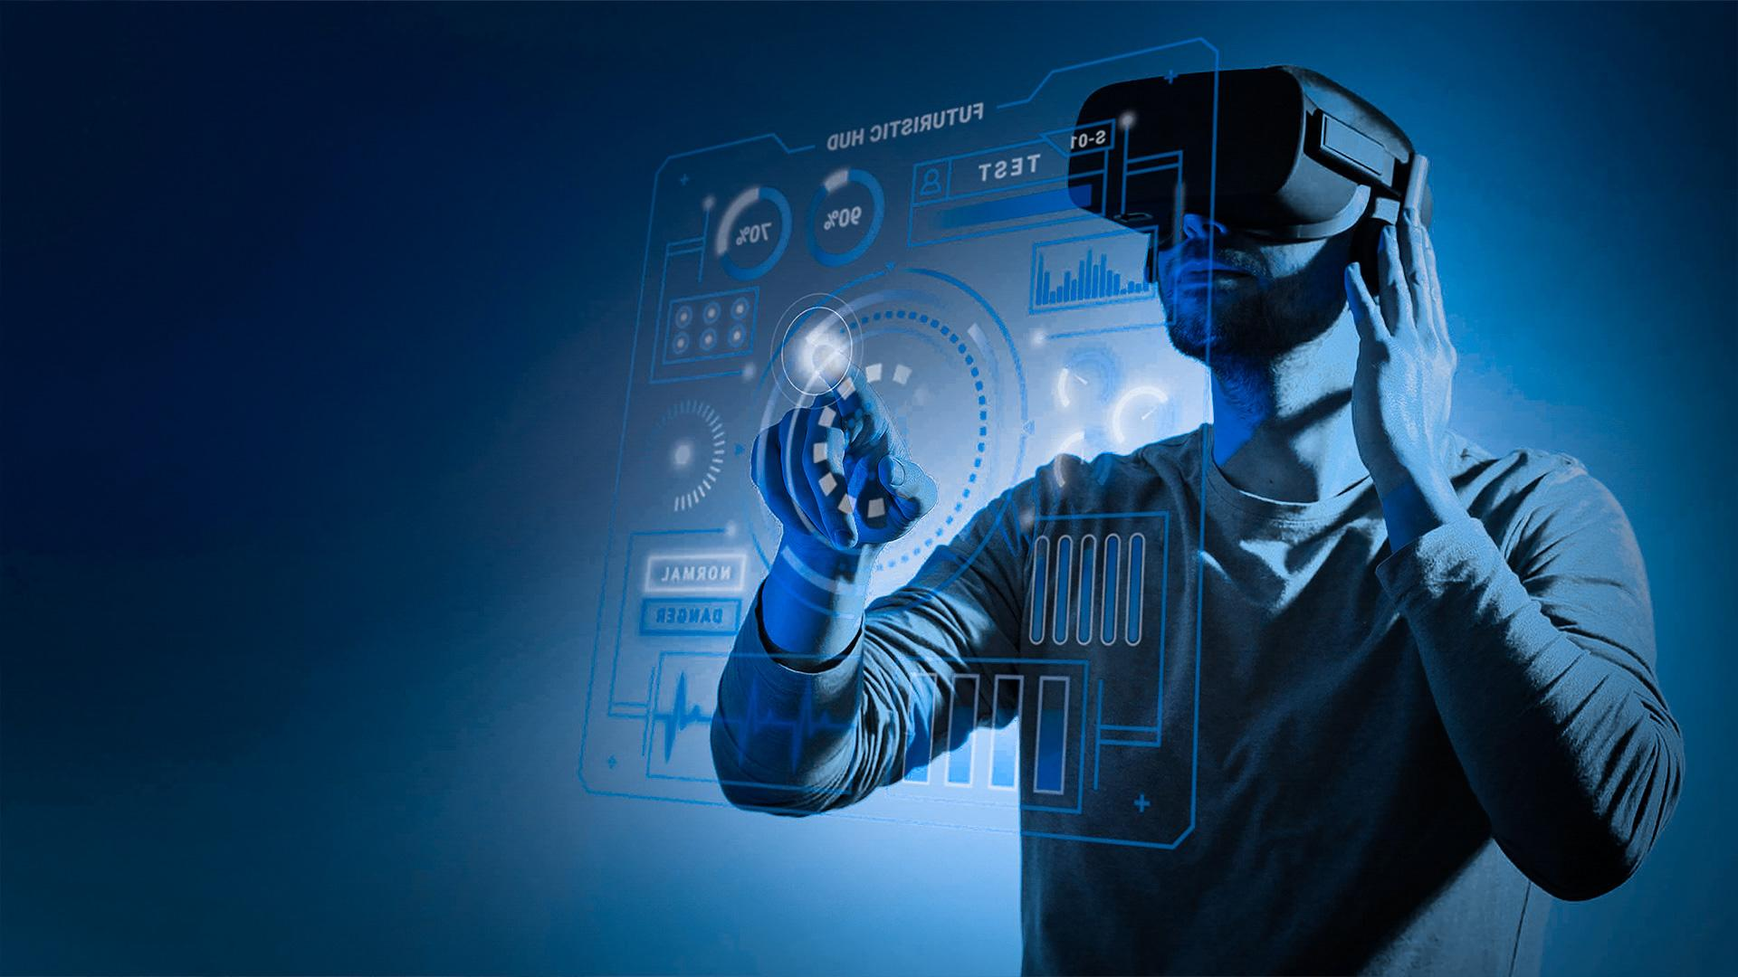

Result
The results of text-to-video generation can be quite impressive, but they also depend on the specific model or tool being used. Overall, text-to-video generation is a rapidly evolving field with the potential to create high-quality and engaging videos from textual descriptions. However, it's important to manage expectations
and understand the current limitations.

